Slide 1

SuperMArt supermart
Supermart Sales
SuperMArt supermart
Presented by: Anaswara Rajesh Tool Used: Microsoft Power BI

Slide 2
agenda
a
Project Topic
Dataset Description
Data Model Overview
Insights& Recommendations
Retail Sales Analysis
Understanding Sales Trend
Improving Business Decisions Using Data
Optimizing Inventory And Profitability
Supermart Grocery Sales Dataset
Retail Transaction Data
Structured Tabular Format For Analysis
Chosen For Real-World Retail Insights And Business Relevance
Tables Used In The Data Model
Relationships Between Tables
Data Normalization And Structure
Rationale Behind Modeling Approach
Key Sales And Profit Findings
Top-performing Products And Regions
Identified Trends And Patterns
Business Challenges Observed
Actionable Recommendations For Improvement

Slide 3

Why this topic?
Retail generates huge sales data
Businesses need insights for better decisions
Helps improve profit and performance

Slide 4
Dataset description
Dataset: Supermart Grocery Sales –Retail Analytics Dataset
The dataset has data on orders placed by customers on a grocery delivery application
Contains transactional sales records from a grocery retail store
Includes order details, product category, sales, profit, region, and customer segments
The dataset is designed with an assumption that the orders are placed by customers living in the state of Tamil Nadu, India.

Slide 5
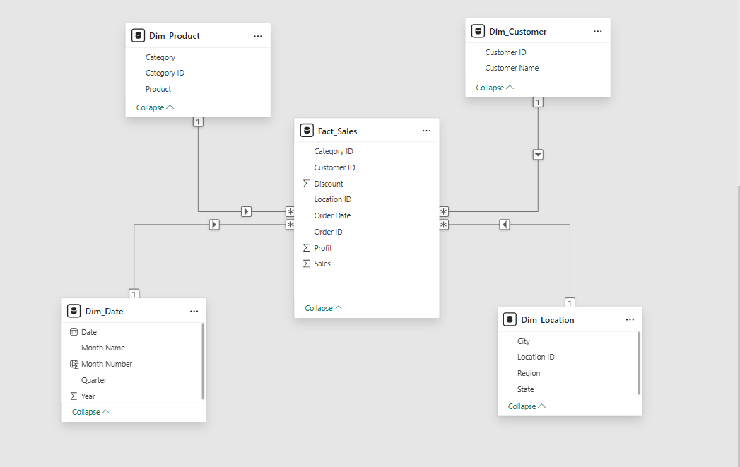
Data model overview
Star Schema Model
Fact Table:
- Fact_Sales : (CategoryID,CustomerID,OrderDate,OrderID,
LocationID,Discount,Sales, Profit)
Dimension Tables:
- Dim_Customer : (CustomerID,Customer Name)
- Dim_Product : (CategoryID,Product, Sub-Category)
- Dim_Date : (Date,MonthName,MonthNumber,Quarter,Year)
- Dim_Location : (LocationID,City,Region,State)
One-to-Many Relationships

Slide 6
insights
1
2
3
Some regions generate higher sales but not always higher profit.
High sales categories sometimes have low profit margins.
A small number of customers contribute most of the revenue.

Slide 7
recommendations
1
2
3
Focus on promoting high-margin products.
Improve pricing and cost control in low-profit categories.
Strengthen loyalty programs for high-value customers.

Slide 8
Thank
thank
Thank
You
You
you
Thank you ☺

